Slide 1

UK Train Rides
UK Train Travel Analytics: Patterns, Ticketing Trends, and Service Performance

Slide 2




We would like to express our sincere gratitude for the opportunity to participate in the EGYPT DIGITAL PIONEERS INTIATIVE “DEPI”. This remarkable program reflects a strong commitment to digital transformation.
Thank you for your continuous efforts in empowering professionals.

Slide 3






Our Team Members
01
02
03
04
05
Heba Youssef Eissa
Rehab Hassan Morgan
Hanaa Refat Mohamed
Marketing Manager
Engineer
Pharmacist At MHP
06
Eman Ahmed Khalifa
Omnia Ramzy Fahim
Nader Samir
Pharmacist At MHP
Senior banker at Banque du Caire
Engineer

Slide 4
PICK UP YOUR BAGS, LET 'S GO
We Will Take You In A Wonderful Journey In Our World Of Data Analysis

Slide 5
Table of Contents
1- Introduction | About the project
2- Objective of the project | Our objectives in this project
3- Questions | Key Data Analysis Questions
4- Data analysis steps | Cleaning using power Query | Using Dax | Using some visuals in power BI to form reports
5- Project spoiler | General outlook on the project
6- Power BI final project | Discussing our final Reports on power BI service
7-key insights and recommendation | Discuss project key insights and our recommendations

Slide 6
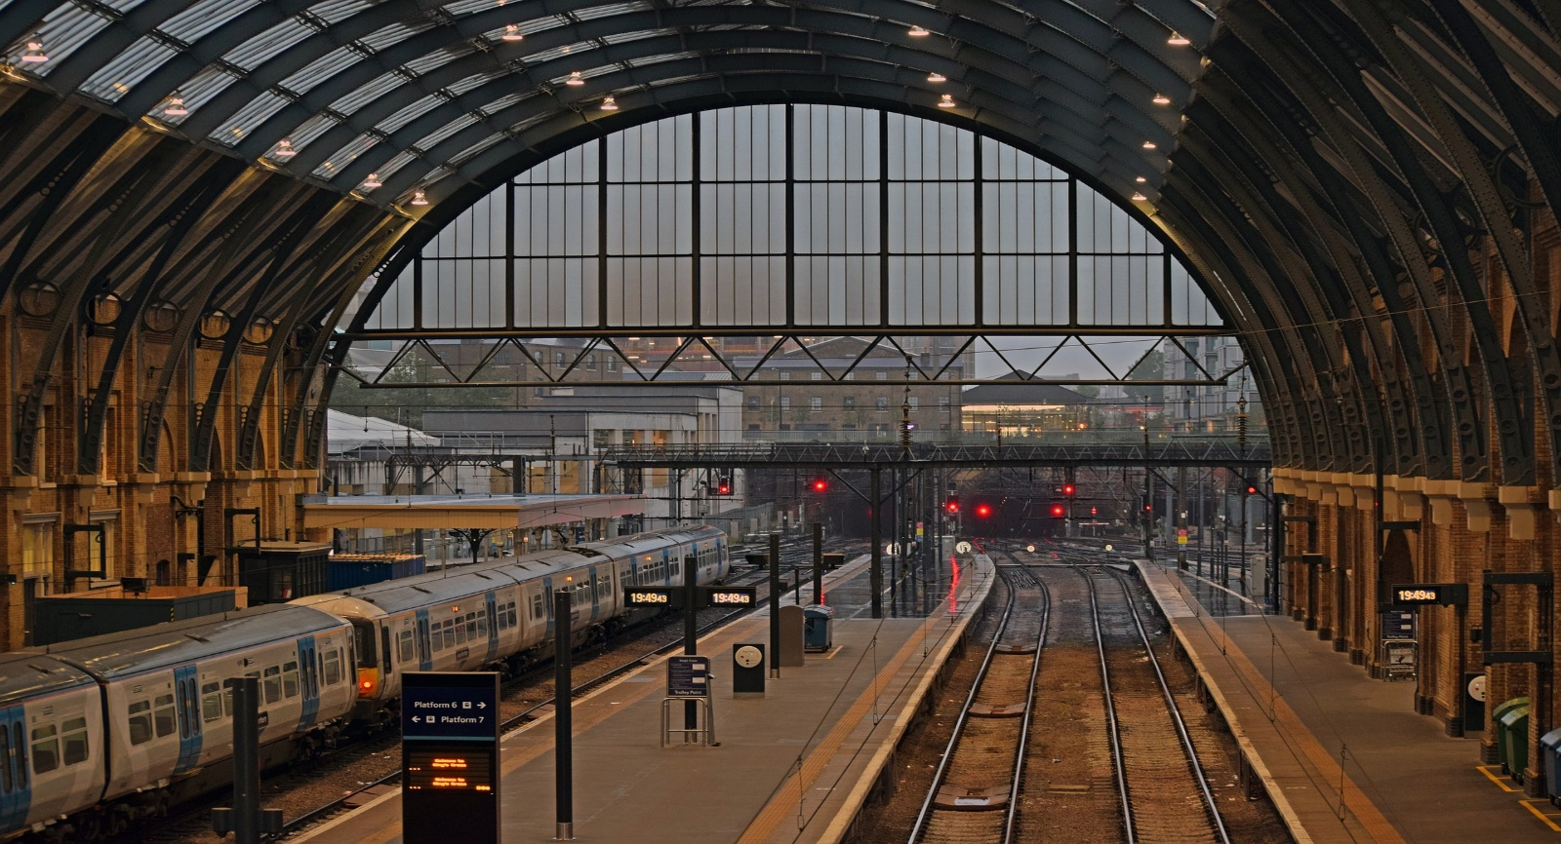
Introduction
01
The UK railway system experiences millions of daily transactions involving ticket purchases, diverse travel routes, and varying journey statuses. However, challenges such as ticket pricing trends, travel demand fluctuations, and train delays significantly impact both commuters and railway operations.
Kings Cross, London

Slide 7

02 Our Objectives
understand the reasons for journey delays and refunds.
Check the distribution of Journey Status and Refund Request to identify any significant trends or patterns.
Examine the relationship between Journey Status, Reason for Delay, and Refund Request to identify key trends and patterns.
Edinburgh Waverley, Edinburgh

Slide 8
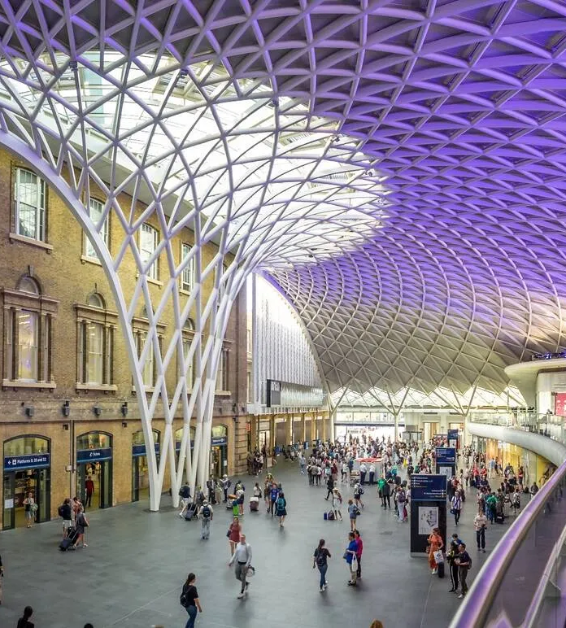
Our Main Goal
To analyze the factors contributing to railway journey delays, cancellations, and refund requests.
Kings Cross, London

Slide 9
03 Key Data Analysis Questions
“These questions guide our next steps in improving rail performance and customer experience.”
Sales & Revenue Analysis
What are total revenue trends and average ticket prices?
Which ticket types and purchase channels perform best?
Passenger Behavior & Booking Trends
How are payment methods distributed?
Do people prefer advance vs. same-day booking?
Route & Station Performance
What are the busiest stations and routes?
Which routes bring in the highest revenue?
Refund & Customer Service Analysis
Are refunds linked to delays, ticket types, or payment methods?
What’s the overall refund rate?
Punctuality & Delay Analysis
What is the delay rate and root causes?
Which routes have the most delays?
How do delays influence refunds?
How does regional demand vary?
How does day of week affect travel behavior?
When do passengers typically book?
Which rail cards drive the most sales?
How do prices differ by ticket class?

Slide 10
04 Data analysis steps
Cleaning
Using Power Query
Data modeling
Using data modeling
DAX
Using Dax in order to get a particular information
Visuals
Using visuals on power BI to represent our data correctly and efficiently

Slide 11
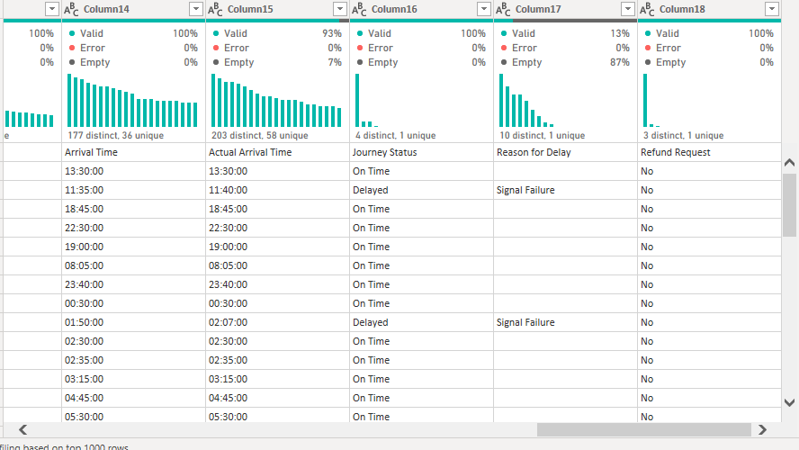
Data before cleaning
Cleaning

Slide 12
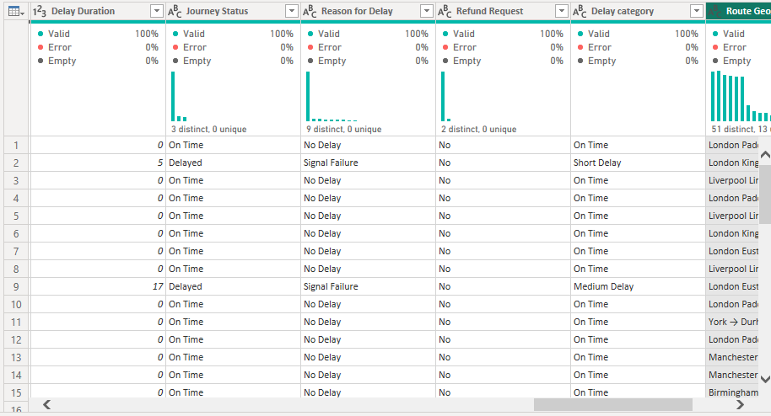
Promote headers
Change types
Replace values
Add custom columns
Handle errors
Reorder columns for better structure.
Data after cleaning

Slide 13
DAX : Examples
DIVIDE
VAR
SUMX
CALCULATE
RETURN
SUMMARIZE
DISTINCTCOUNT
FILTER

Slide 14
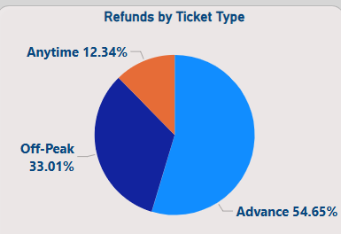
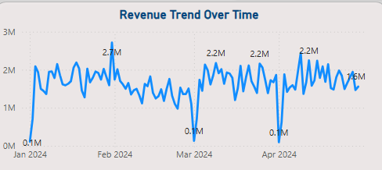
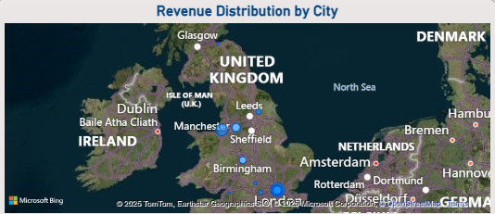
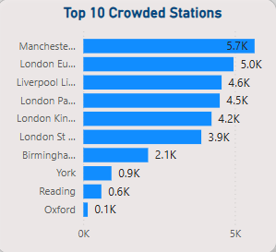
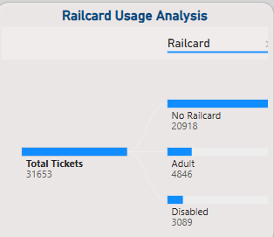
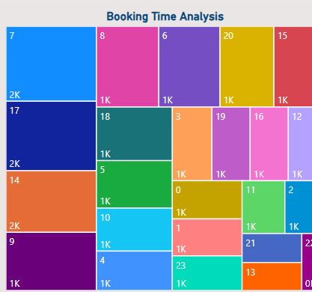
Visuals: Examples
Pie chart
Line chart
Map
Bar chart
Decomposition tree
Tree map

Slide 15
05 Project spoiler
Overview
Trip Analysis
Delays & Cancellations
General overview of railway performance
Analyzing trip patterns and bookings
Understanding the reasons for delays and cancellations
Refund Requests
Revenue Analysis
Passenger Behavior
Geospatial Analysis
Detailed Reports
Analyzing ticket refunds based on delays
Identifying key revenue sources
Understanding passenger preferences and booking methods
Displaying data on interactive maps
Presenting

Slide 16


Slide 17
07 Key insights
1. Key Hubs Drive Traffic & Revenue
Manchester Piccadilly leads in trips; London Kings Cross leads in revenue. Major routes dominate flow.
2. Revenue Concentrated in Advance Tickets & Online Sales
Advance tickets = 64% of revenue. Most payments via credit card. Online = 59% of sales.
3. Delays & Cancellations Are Common
4.1K affected journeys, 1.8K canceled. Main causes: technical and signal issues.
4. Refunds Have Noticeable Impact
1.1K refunds worth £39K. Most due to technical failures, signal issues, and staff shortages.
5. Some Stations Underperform
York and Reading have low use. Northern routes trail in traffic and revenue.

Slide 18
Recommendations
1. Boost High-Traffic Routes
Add trains on key routes (e.g., Birmingham → Manchester) and apply peak-hour pricing.
2. Cut Delays & Cancellations
Upgrade tech, maintain signals, and use analytics to avoid staff/equipment issues.
3. Grow Digital Sales
Enhance online booking with loyalty rewards. Promote contactless payments in underused areas.
4. Revive Low-Traffic Stations
Offer deals for York, Reading, and partner with local tourism to drive demand.
5. Reduce Refund Costs
Offer vouchers instead of cash and improve support for delayed passengers.

Slide 19
Thanks!
Do you have any questions?
The train has arrived the station

